Slide 1


FPDF is a PHP class which allows to generate PDF files with pure PHP, that is to say without using the PDFlib library.
How We Generate PDF
Main features
Choice of measure unit, page format and margins
Automatic line break and text justification
Image support (JPEG, PNG and GIF)
Colors
Links
Page compression

Slide 2



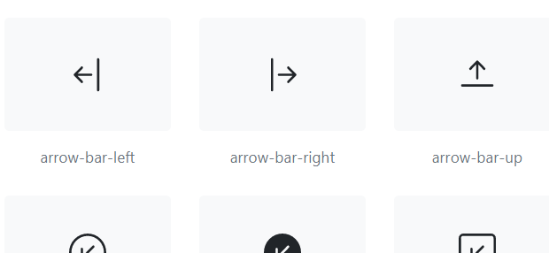


Bootstrap Framework HTML & CSS Templates Responsive Website
CSS FRAMEWORK & ICONS
Font Awesome icon toolkit

Slide 3

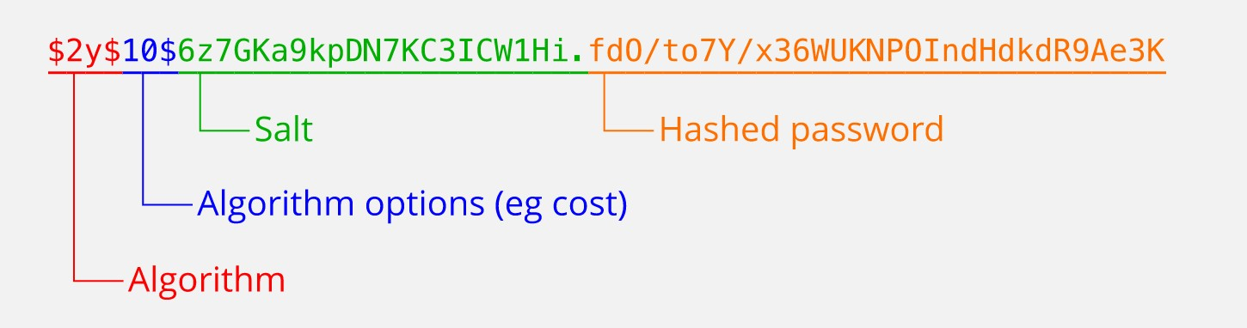
Encryption
Huge Number of Hash Database
1,154,870,188,082
Message-Digest Algorithm
Produce 128-bit hashed value
Not Reversible Function

Slide 4

Online Meetings
Schedule a Meeting
Use Google
Meet
Use Zoom
Google Meet is a video-communication-service developed by Google.
Zoom Video Communications, Inc. is an American communications technology company, It provides video telephony

Slide 5



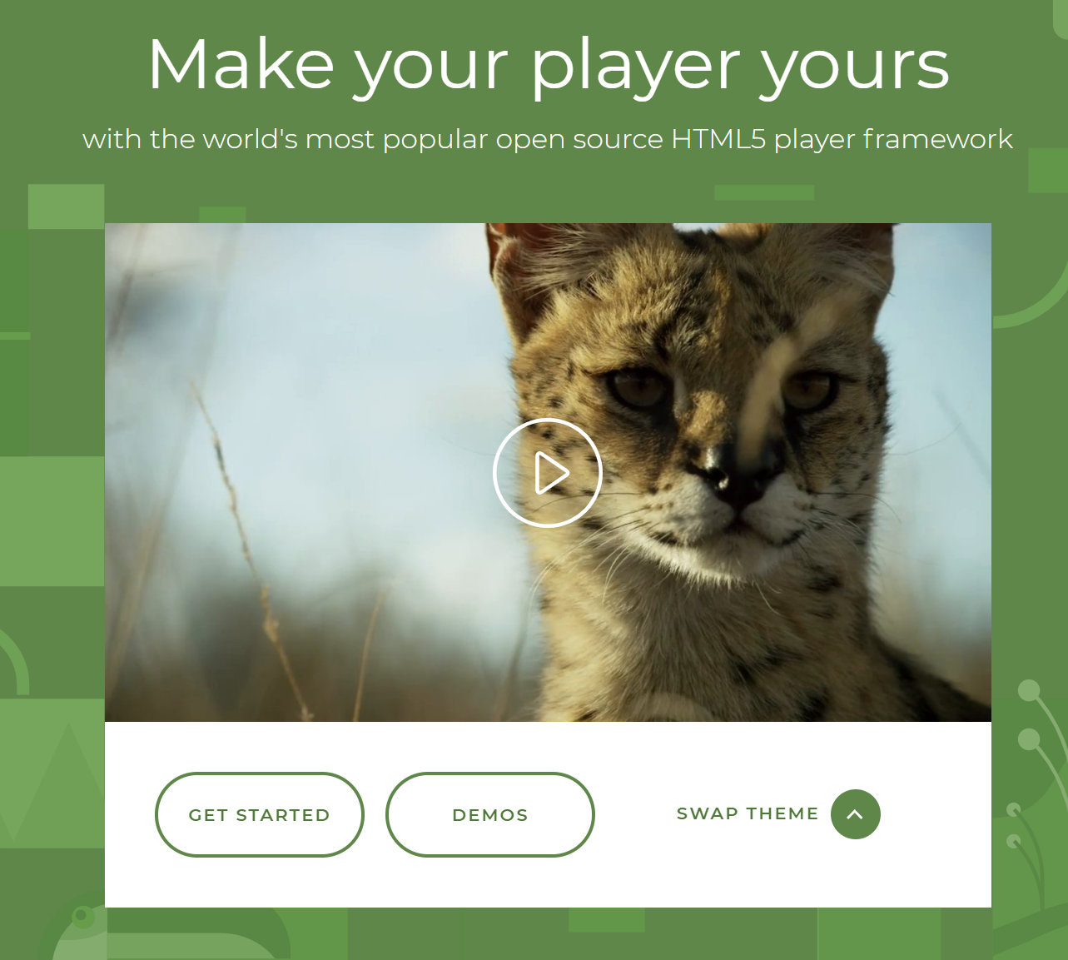
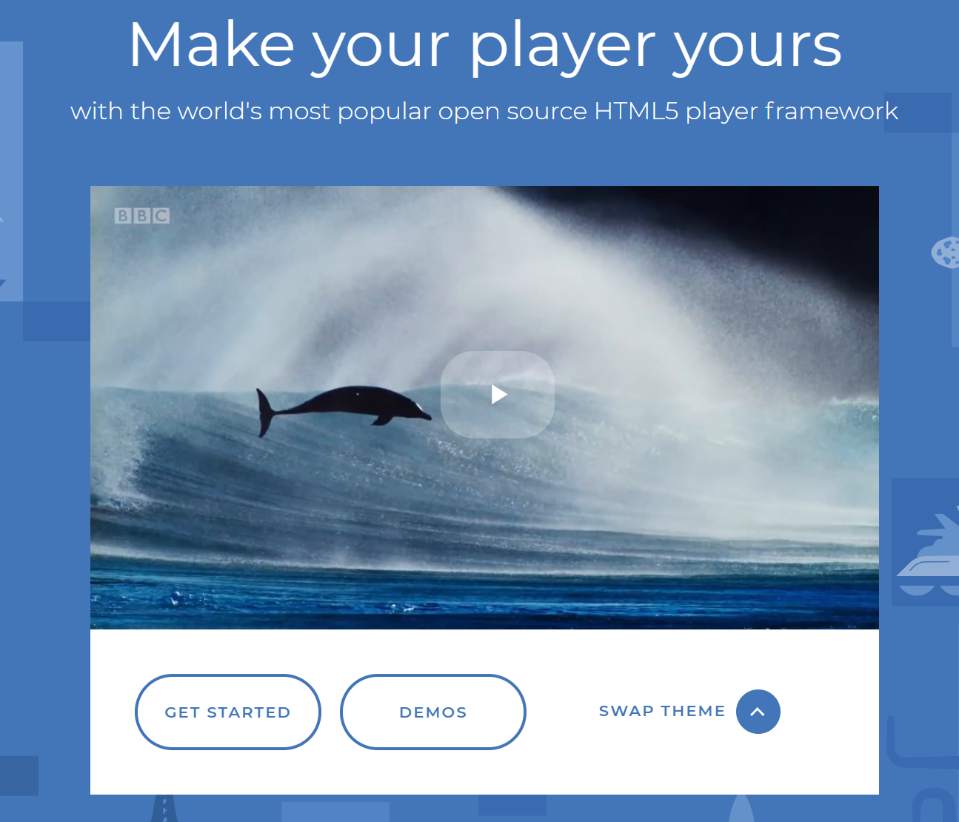
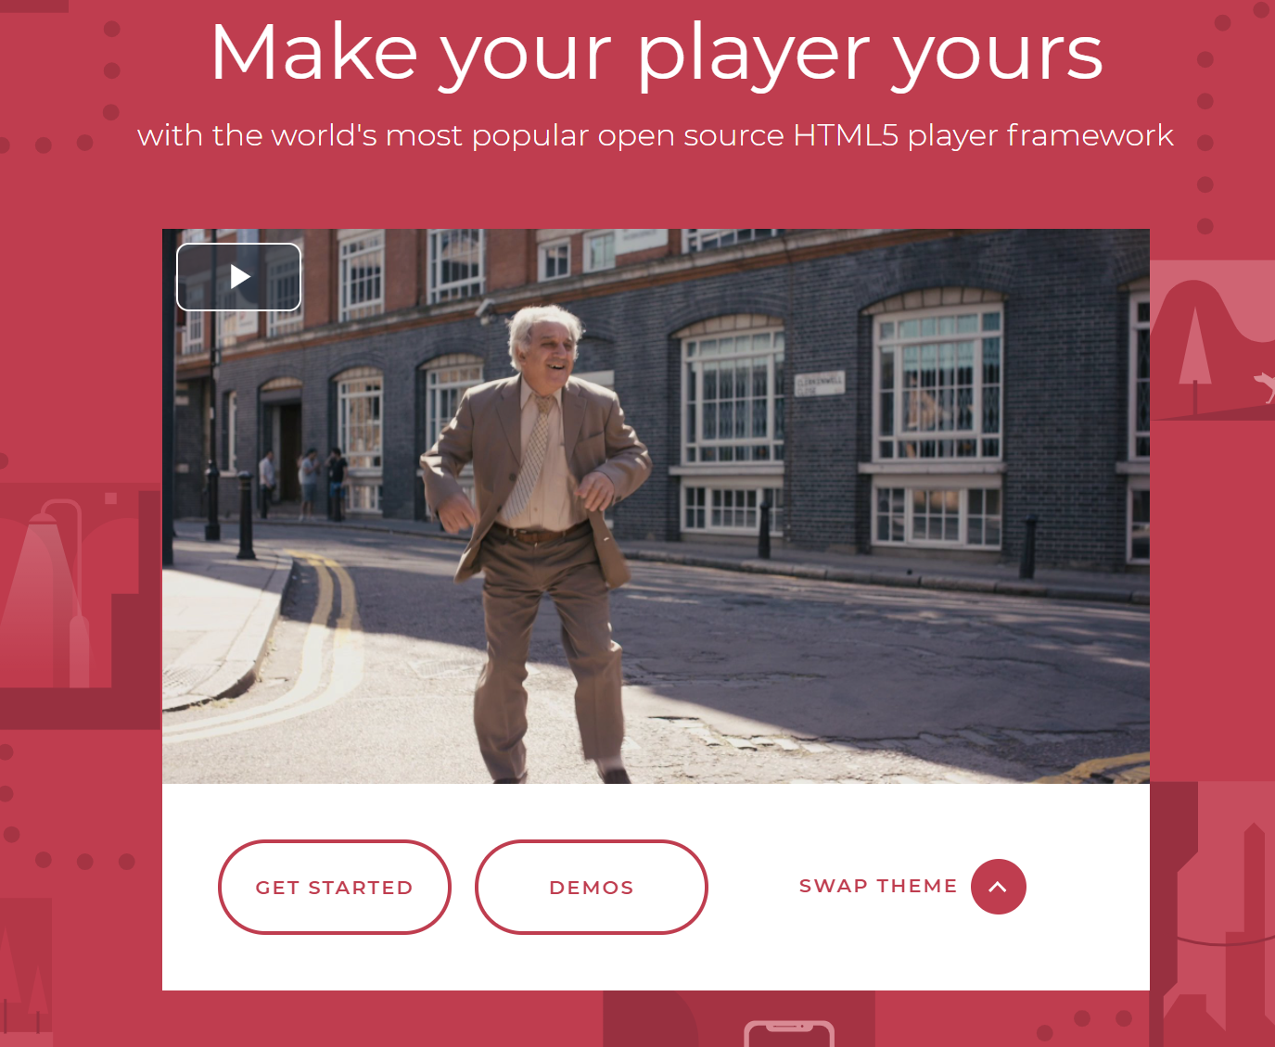
Media Player
Supports HTML5 video and streaming
Easy Plugins install Chromecast, IMA
Reliable and Consistent
Play Any format Videos

Slide 6
Conclusion

